Slide 1
Communication Strategies for Vaccine Confidence:
Introduction
WEEK 1 Live Session
October 14, 2021
Notes:
Hello, thank you for participating in the National Nurse-Led Care Consortium’s Communication Strategies for Vaccine Confidence Learning Collaborative.
My name is Deepa Mankikar, Senior Project Manager at NNCC. I am joined today by my colleagues, Darlice Rocha, Project Coordinator, and Monica Harmon, public health nurse, educator and researcher.
We are thrilled to have you here.

Slide 2
The National Nurse-Led Care Consortium (NNCC) is a non-profit membership organization that supports nurse-led care and nurses at the front lines of care.
NNCC supports comprehensive, community-based primary care and public health nursing through policy and advocacy, program development and management, technical assistance and support, and direct, nurse-led healthcare services.
Notes:
The National Nurse-Led Care Consortium is a nonprofit member-supported organization working to strengthen community health through quality, compassionate, and collaborative nurse-led care.
NNCC represents the intersection of nurse-led primary care and public health.
Our mission is to advance nurse-led health care through policy, consultation, and programs to reduce health disparities and meet people’s primary care and wellness needs.
NNCC is an affiliate of the Public Health Management Corporation.

Slide 3
COVID Vaccine Project Goals
Empower nurses with necessary information to engage care teams and communities about COVID-19 vaccines.
Provide learning opportunities to share up-to-date guidance, support peer engagement among nursing colleagues, and strengthen the nursing role.
Amplify the nursing voice by featuring nurse champions through our podcast and other media outlets.
Notes:
NNCC is partnering with the Centers for Disease Control and Prevention (CDC) to build COVID-19 vaccine confidence among nurses and the communities they serve.
Through this project, we aim to:
Empower nurses with the necessary information to engage with care teams and communities about COVID-19 vaccines;
Provide learning opportunities to share up-to-date guidance and support peer engagement among nursing colleagues; and
Amplify the nursing voice by featuring everyday nurse champions through our podcast and other media.
Please visit nurseledcare.org to learn more.

Slide 4
ABOUT THE SERIES
A 4-part FREE online educational series for nurses to learn key communication strategies and resources to have meaningful and effective conversations about COVID-19 vaccines with patients and colleagues.
Each interactive session includes individual and small group exercises to practice communication strategies. We will cover the power of personal storytelling, leveraging social media, and guiding one-on-one vaccine conversations.
NNCC recently launched a COVID-19 vaccine toolkit, designed to give you the tools to support immunization in your community.
#NursesMakeChangeHappen
This project was funded in part by a cooperative agreement with the Centers for Disease Control and Prevention (grant number NU50CK000580). The Centers for Disease Control and Prevention is an agency within the Department of Health and Human Services (HHS). The contents of this resource center do not necessarily represent the policy of CDC or HHS, and should not be considered an endorsement by the Federal Government.
NNCC VACCINE CONFIDENCE TRAINING
Notes:
NNCC is offering a 4-part FREE online educational series for nurses to learn key communication strategies and resources to have meaningful and effective conversations about COVID-19 vaccines with patients and colleagues. Through this series, we intend to create a space where we can facilitate supportive conversations and learning across the nursing community.
Each interactive session includes individual and small group exercises to practice communication strategies. We will cover the power of personal storytelling, leveraging social media, and guiding one-on-one vaccine conversations.
NNCC recently launched a COVID-19 vaccine toolkit, designed to give you the tools to support immunization in your community.
Follow along by using hashtag #NursesMakeChangeHappen

Slide 5
TODAY’S LEARNING OBJECTIVES
Understand the learning series guidelines and preview of topics that will be explored.
Describe the role of health communication in relation to COVID-19 information.
Introduce NNCC’s national media campaign #NursesMakeChangeHappen.
NNCC VACCINE CONFIDENCE TRAINING

Slide 6
EXPECTATIONS FOR THE SERIES
Please listen to the designated week’s recording prior to attending that week’s session
Participate in the four one-hour live online learning sessions, weekly
Be willing to participate in post-series surveys
Registration is free of charge and 1 CEU will be offered for each training. Attendees must complete the evaluation to receive CEU certificate. Learn more here.
NNCC VACCINE CONFIDENCE TRAINING
Notes:
Here are a few rules and expectations for participants.

Slide 7
SCHEDULE
All live sessions will take place via Zoom. In preparation for the live sessions, participants will receive additional video recordings that provide an overview of the topic that week.
Module 1: Introduction
Module 2: How to Tell Your Story
Module 3: Sharing Information Through Social Media
Module 4: Guiding One-On-One-Conversations
NNCC VACCINE CONFIDENCE TRAINING

Slide 8
AGENDA
Introductions (10 minutes)
Break Out Activity (10 minutes)
Report Out (5 minutes)
Presentation & Toolkit Walk-through (20 minutes)
Discussion/Questions (10 minutes)
Close & Debrief (5 minutes)
NNCC VACCINE CONFIDENCE TRAINING
Notes:
Since today is our 1st session, we actually flipped our agenda, to have break-out groups in the beginning, followed by a brief presentation, discussion, and close/debrief.
In future session, the breakout activity will typically occur in the 2nd half of the session, after a didactic presentation.

Slide 9
ZOOM ETIQUETTE
Keep yourself on mute when not speaking
Share your video
Snacks and lunch are okay!
Take breaks when you need
Respond to prompts and activities
NNCC VACCINE CONFIDENCE TRAINING

Slide 10
INTRODUCTIONS
NNCC VACCINE CONFIDENCE TRAINING

Slide 11
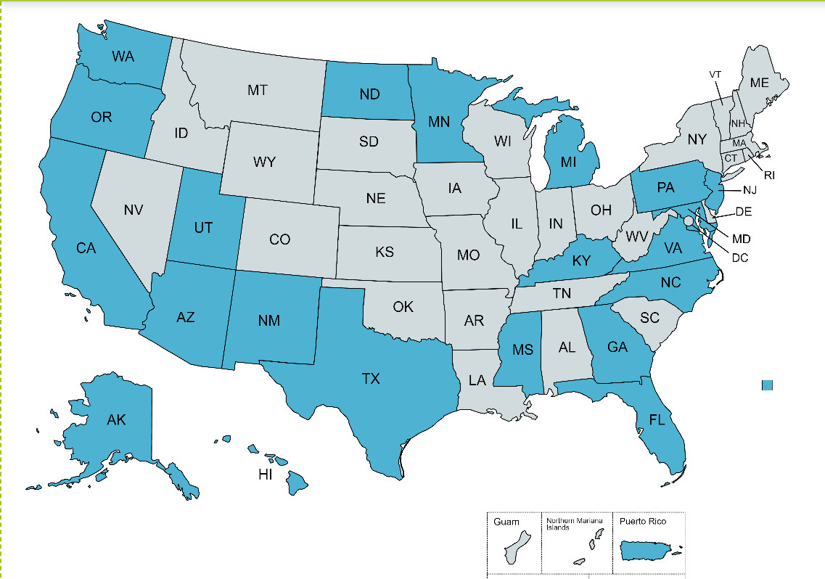
LEARNING COLLABORATIVE PARTICIPANTS
NNCC VACCINE CONFIDENCE TRAINING

Slide 12
NNCC VACCINE CONFIDENCE TRAINING

Slide 13
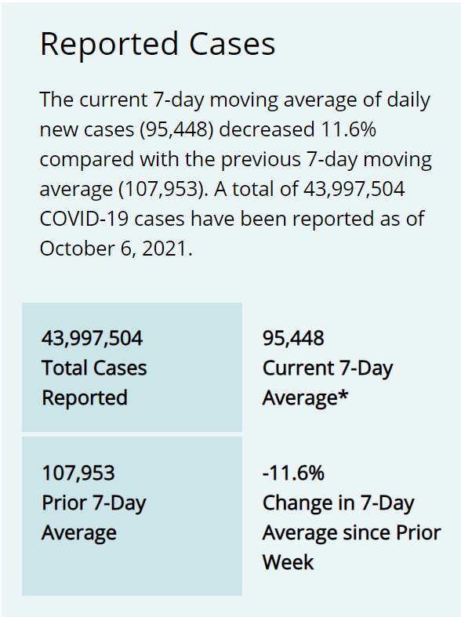
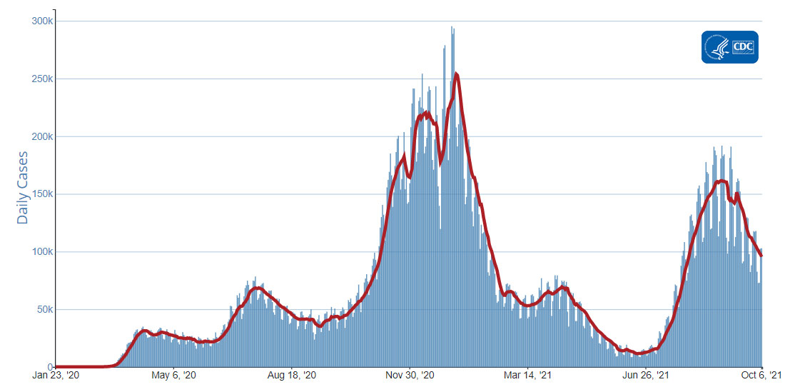
https://www.cdc.gov/coronavirus/2019-ncov/covid-data/covidview/index.html
NNCC VACCINE CONFIDENCE TRAINING
Notes:
Data as of Oct. 12, 2021

Slide 14
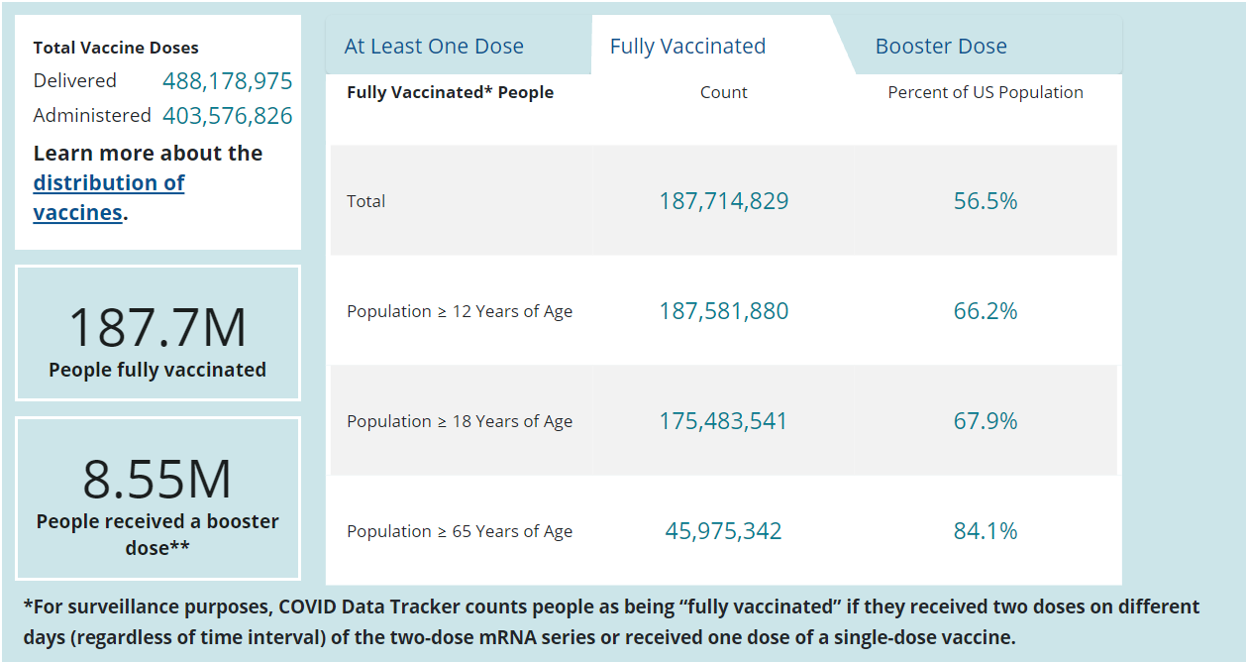
https://covid.cdc.gov/covid-data-tracker/#vaccinations_vacc-total-admin-rate-total
NNCC VACCINE CONFIDENCE TRAINING
Notes:
Data as of Oct. 12, 2021
Individuals 12 and older are eligible to receive a vaccine. Among the eligible population, just 66% are fully vaccinated. There is more work to be done.

Slide 15
BREAK OUT GROUPS
ICE BREAKER
NNCC VACCINE CONFIDENCE TRAINING

Slide 16
ICE BREAKER
(10 min)
Introduce yourself + your job/org
What challenges are you facing regarding vaccine hesitancy in the population you serve?
NNCC VACCINE CONFIDENCE TRAINING
Notes:
What brings you to this series?
Describe the population you serve:
Children
Elderly
Rural
City

Slide 17
REPORT OUT
What were some of the challenges you heard?
What resonated with you?
NNCC VACCINE CONFIDENCE TRAINING

Slide 18
HEALTH COMMUNICATION
NNCC VACCINE CONFIDENCE TRAINING

Slide 19
COMMUNICATE WITH CONFIDENCE
What is Vaccine Confidence?
Vaccine confidence is the trust that patients, their families, and providers have in:
Recommended vaccines
Providers who administer vaccines
Processes and policies that lead to vaccine development, licensure or authorization, manufacturing, and recommendations for use
https://www.cdc.gov/vaccines/covid-19/vaccinate-with-confidence/building-trust.html
NNCC VACCINE CONFIDENCE TRAINING
Notes:
The CDC recognizes the importance of building trust in the COVID-19 vaccines through their initiative “Vaccinate with Confidence”. You might be wondering what that term means?
Vaccine confidence is the trust that patients, their families, and providers have in:
Recommended vaccines
Providers who administer vaccines
Processes and policies that lead to vaccine development, licensure or authorization, manufacturing, and recommendations for use
Many factors influence vaccine decision-making, including cultural, social, and political factors, individual and group factors, and vaccine-specific factors.

Slide 20
Notes:
The World Health Organization notes that healthcare workers have a major influence on vaccine update. A Healthcare worker’s strong recommendation and relationship with a patient can support them in their decision to be vaccinated.
In addition, a Kaiser Family Foundation Poll from June 2021 shows healthcare providers were rated the most trusted source for reliable COVID-19 Vaccine information. This level of trust for healthcare workers, especially for people’s personal healthcare providers, was seen across both vaccinated and unvaccinated adults.
(https://www.kff.org/coronavirus-covid-19/poll-finding/kff-covid-19-vaccine-monitor-june-2021/)

Slide 21
Risk perception and decision-making
Disease and vaccination are associated with risk.
A person may think disease is likely and/or severe and may feel vaccine side-effects are likely and/or severe.
The general rule:
if people perceive high levels of risk of disease, they will be more likely to vaccinate;
if people perceive high levels of risk of vaccination, they will become less likely to vaccinate.
WHO. 2017. Vaccination and trust
14
Notes:
Risk perception plays a big role in decision making.
If someone perceives being at high risk for a disease, they will be more likely to be vaccinated.
In the same sense, if someone perceives high risk with vaccination, they will be less likely to be vaccinated.

Slide 22
Communicating risk
Vaccination requires effective
risk communication
It is essential that the public:
understands the risks associated with vaccine- preventable diseases;
understands the benefits and risks associated with vaccines;
knows where to find accurate, trustworthy and clear information about these.
Common for new vaccines to be met with initial hesitancy.
Public concern about vaccine safety can reduce vaccine coverage rates and result in the resurgence of vaccine‐preventable diseases.
Goal of effective risk communication: Develop an informed decision‐making partnership.
Health Workers play a vital role in the success of immunization programs by providing information through risk communication.
Risk perception is influenced by experience as well as personal, religious and cultural contexts.
When communicating risk with patients be aware of cultural and emotional differences keeping in mind some people are adversarial or misinformed.
Lewandowsky, S., et al. 2021. The COVID-19 Vaccine Communication Handbook; WHO. 2017. Vaccination and trust
15
Notes:
Therefore, it’s our job to do our best when communicating risk.
Public health messages should relay:
The risks associated with vaccine-preventable diseases
The benefits and risks associated with vaccines –especially focusing on vaccine safety.
And where to find accurate, trustworthy information about this.

Slide 23
COVID-19 vaccine risk communication
Key risk communication points for your conversation:
1.
Provide reassurance the COVID-19 vaccine is safe and effective, providing protection against coronavirus.
2.
Proactively explain potential side-effects of COVID-19 vaccine (common and rare)
3.
Promote safety of the COVID-19 vaccines
4.
Discuss effectiveness of COVID-19 vaccines and continued recommended precautions to decrease risk of COVID-19 disease.
5.
Recommend pain mitigation strategies
NOTE: See more resources to support health workers in COVID-19 risk communication at end of module
Notes:
Here are 5 tips to shape conversations about vaccines.
1. Provide reassurance the COVID-19 vaccine is safe and effective and protect against the coronavirus.
2. Proactively explain potential side-effects of COVID-19 vaccine (common and rare)
3. Promote safety of the COVID-19 vaccines
4. Discuss effectiveness of COVID-19 vaccines and continued precautions like masking to decrease risk of COVID-19.
5. Discuss pain mitigation strategies (esp. for those concerned about short term side effects).

Slide 24
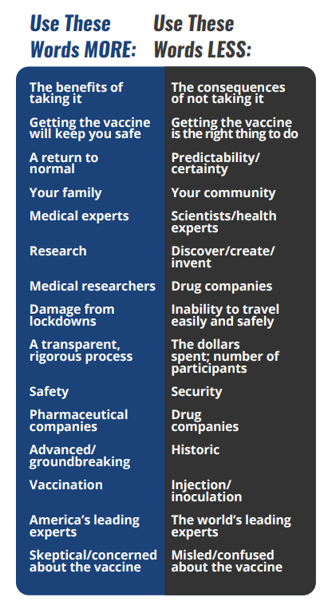
CONVERSATION CHEAT SHEET
www.changingthecovidconversation.org
NNCC VACCINE CONFIDENCE TRAINING
Notes:
This graphic comes from a handout by the de Beaumont Foundation. (It can be found in our Google Drive folder for today’s session).
You can check out more resources like this at www.changingthecovidconversation.org

Slide 25
KEY TAKEAWAYS
de Beaumont Foundation survey
NNCC VACCINE CONFIDENCE TRAINING
Notes:
The de Beaumont Foundation has partnered with pollster Frank Luntz conducted a national poll to identify effective ways to communicate about the COVID-19 vaccine to all Americans, including those who are concerned about getting vaccinated.
The survey included 1,400 registered voters who were a representative sample of Americans by political affiliation, age, gender, ethnicity, income.
Their focus was specific words and phrases that Americans need to hear to reduce concerns and increase trust in taking the COVID-19 vaccines. Here are a few key messages.

Slide 26
Notes:
Public concerns are sometimes related to not knowing the vaccine’s review process.
According to the poll findings, here are some messages that would give people the most trust and confidence in the vaccines.
You want to relay the following: [read slide]

Slide 27
Notes:
Public concerns are sometimes related to side effects.
In this case, you want to relay the following: [read slide]

Slide 28
Notes:
And lastly, the following messages were voted on as most convincing and compelling for getting vaccinated.
[read slide]
For more information on key messages and findings from the survey, check out www.changingthecovidconversation.org

Slide 29
TOOLKIT WALK THROUGH
NNCC VACCINE CONFIDENCE TRAINING

Slide 30
Notes:
We know that nurses are essential for building vaccine confidence and trust, and we are here to support the nursing workforce prepare for important conversations and decision-making.
NNCC recently launched a national campaign #NursesMakeChangeHappen and a COVID Vaccine Toolkit designed to give you the tools to support immunization in your community.

Slide 31
NURSE TOOLKIT CONTENTS
Guide to Sharing Your Story This downloadable PDF will guide you through the creation of your story - complete with examples and a how-to guide.
Social Media Pack These templates and guide will help you to share your story or information with others, specifically on social media.
Guide to Combating Misinformation This downloadable contains a series of PDFs that walks through vaccine misinformation, history, and shareable facts.
How-to-Guides These downloadable guides will help guide you through overcoming barriers, correcting misinformation, and providing resources to your community.
NNCC VACCINE CONFIDENCE TRAINING
Notes:
Our Nurses Toolkit was created to arm nurses with the tools, information, and guidance they need to share their story and help correct misinformation about the COVID-19 vaccine. Here’s what’s included in the Toolkit:

Slide 32
nurseledcare.org/toolkit
Notes:
Check out the toolkit at www.nurseledcare.org/toolkit

Slide 33
Please submit questions through this Google Form. We will address them during the live sessions.
Notes:
Please submit any questions you have using this Google Form. This link will also be found in your welcome email from NNCC.
We will address questions during the live session next week.

Slide 34
Notes:
Thank you for tuning in to this session. Please complete the post-session quiz to receive CE credits. The link will be available in the Google folder in the next day or so.
Our team will be in touch on Monday with materials for Week 2. Thanks everyone!

